Slide 1



World clock application
Alexander cosmas

Slide 2
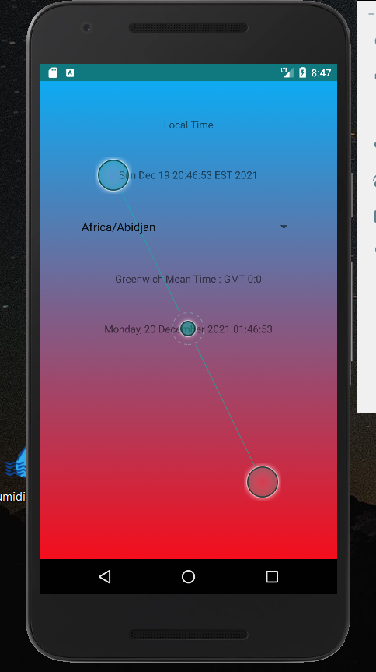
Home screen
Local time and date displayed
Dropdown selector for different time zone
Displays GMT
Displays time and date of selected region

Slide 3
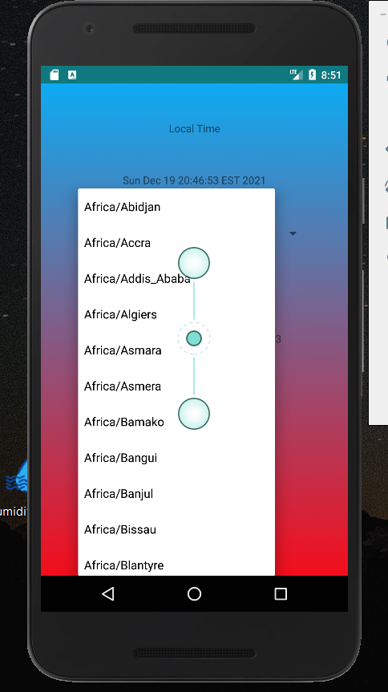
Dropdown display
Allows for the selection of your country/ region

Slide 4
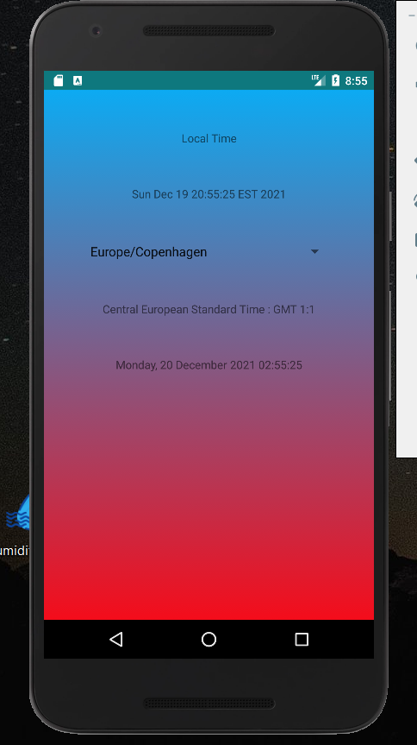
Once your selection is made you see your local time and date displayed
You also see the selections time and date displayed

